Slide 1



COGNIASSESS Non-Technical roles Assessment

Slide 2
TABLE OF CONTENTS
01
02
03
04
05
07
Model Training and PEFT
Introduction
08
Model Merging and Deployment
Data Collection
Exploratory Data Analysis
09
Testing Results
10
Frontend Development
Data Preprocessing
11
Project demo
Model selection and Config
06
12
FYP II goals
Training environment setup

Slide 3
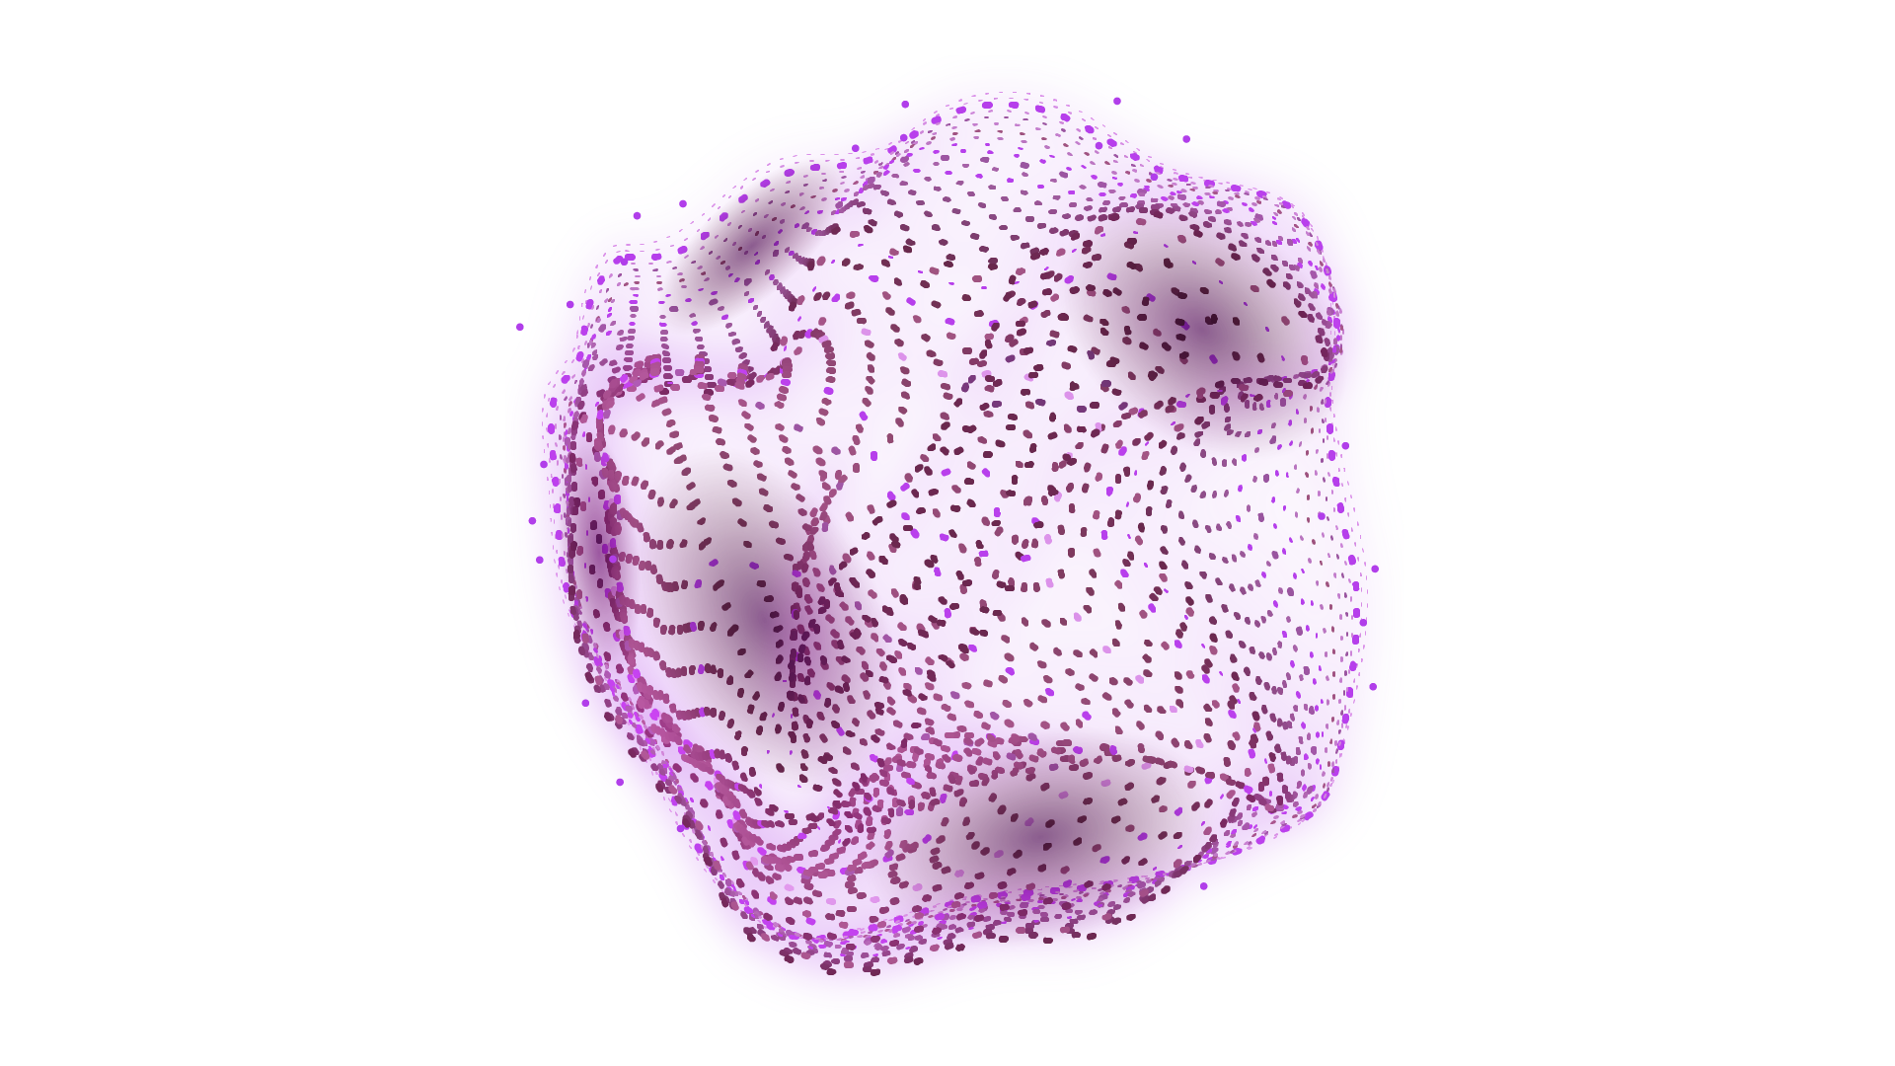

Introduction
Objective: Transforming non-technical role recruitment using AI and Large Language Models (LLMs).
Features:
For Candidates: Easy registration, role selection, personalized assessments for soft skills, recruiter connections, and guidance
Non-Technical and personality assessing Question Generation: Generate relevant and diverse questions assessing soft skills based on selected roles and domains.
Automated Evaluation: Automated evaluation of candidates' responses to gauge non-technical competencies.
Personalized Feedback: Provides tailored feedback to candidates based on their assessment performance.
And many more…

Slide 4
Introduction
Process: Enhance open-source LLM to accurately assess non-technical skills in recruitment.
Steps
Data Preparation: Collecting and processing diverse datasets relevant to non-technical roles, soft skills, and the ability of the model to role play.
LLM selection: Selection most suitable base model to finetune
Initial Training: Utilizing base LLM and training it on these specialized datasets using optimal resources.
Model deployment and Testing: Deploying the adapter and merging the weights with the base model and then deploying the merged model
Outcome: A robust, AI-driven system for effective and efficient non-technical skill evaluation in recruitment.

Slide 5




Introduction
Main Technologies Used

Slide 6
Data Preparation
Data Sources:
QnA for Non-Technical Roles: Questions and answers specific to non-technical job roles.
Introduction Training: Introductory level training materials and queries.
Roleplay Training: Roleplay scenarios and responses for practical insights.
Selection Criteria:
Alignment with Non-Technical Skills: Data must reflect various non-technical roles and skills.
Diversity and Inclusivity: Covering a broad range of scenarios, roles, and domains.
Quality of Content: Emphasis on clarity, correctness, and relevance.
Adaptability for AI Training: Compatibility with AI analysis and modeling.

Slide 7
Exploratory Data Analysis

Slide 8
Motivation
Predominant emphasis on technical competencies in professional success results in overlooking Importance of non-technical roles alongside technical competencies
Existing tools majorly assess technical expertise
Lack of customization and role-specific assessments in existing tools results in candidates lacking informed decision making due to generic evaluations
Biasness in Recruitment as in a survey by Glassdoor found that 61% of recruiters in the tech industry believe they have been hired due to unconscious bias.
Manual Assessment creation process in a hassle for the recruiter as well

Slide 9
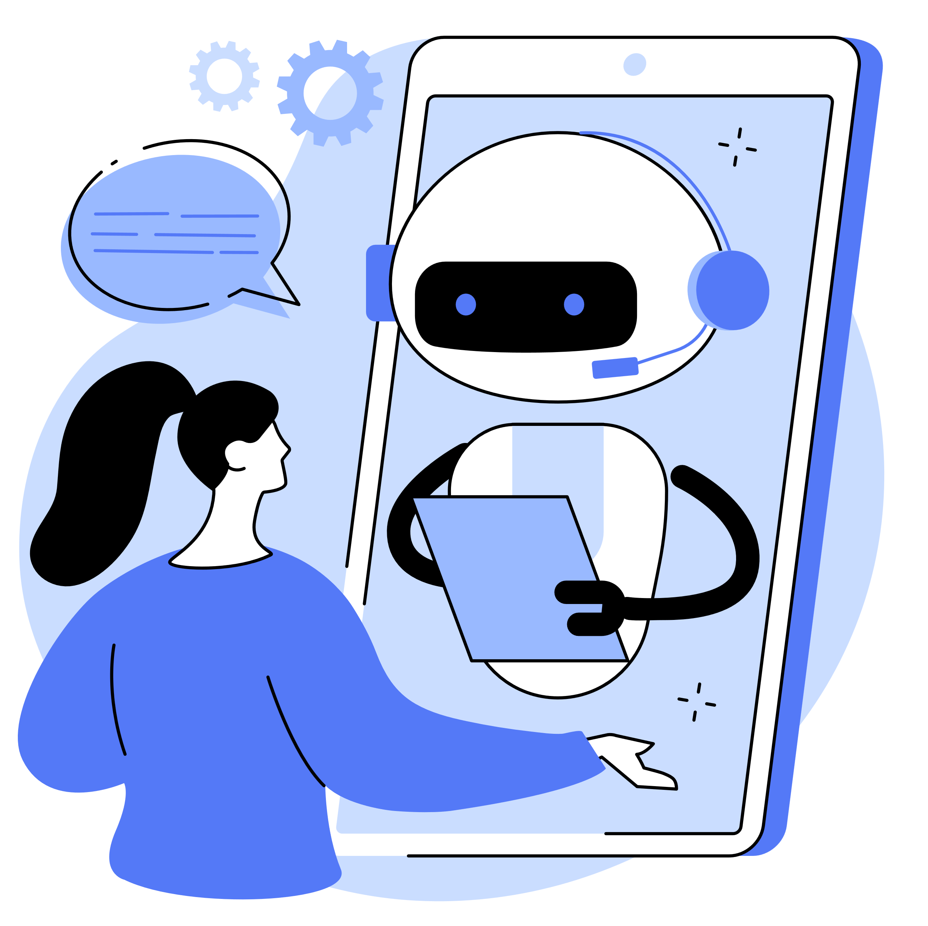


Literature Review
AI-based assessments measure candidates' capabilities and provide feedback, with 69% of talent professionals seeing them as crucial for future hiring.
Chatbots, preferred by 58% of job seekers, facilitate interaction during the application process by providing information and gathering data.
AI minimizes hiring bias by anonymizing data and establishing consistent evaluation criteria, thus improving diversity, with 79% of executives agreeing to its effectiveness in enhancing workforce diversity.
AI predicts candidate success and attrition by analyzing data from resumes and past hires; Unilever’s use has increased hiring quality by 16% and reduced attrition by 39%.
AI models streamline hiring through enhanced sourcing, screening, and skills assessment, enabling performance prediction.
Through analysis of historical data, AI predicts hiring needs; IBM uses it for workforce forecasting, recommending actions like reskilling and redeployment.

Slide 10
Existing Solutions
Features | Cogniassess | TestGorilla | Vervoe | Hirevue
Role-Specific Customization | Yes | No | Yes | Yes
LLM-Driven Modules | Yes | No | No | No
Questions / Scenario generation | Yes | No | Mixed | No
Proctoring | Yes | No | No | Yes
Personalized Feedback | Yes | No | Yes | No
CV analysis | Yes | Yes | Yes | Yes
Roadmaps Suggestions | Yes | Yes | Yes | Yes
Connect with Recruiter | Yes | Yes | Yes | Yes

Slide 11






Our Solution
Assess a diverse array of roles, including:
BPO Customer Service Professionals
Technical Writers,
Content Developers
Social Media Marketers
Finance Managers
Human Resources Executives
Using fine tuned LLMs for role-specific simulations, scenario-based assessments, and role-play simulations to gauge skills effectively.
Analysis of deficiencies in a candidate , Offering personalized and role-specific evaluations. Integrating LLM and AI for accurate and unbiased assessments.
Effective use of AI in minimizes hiring bias
Anti-Cheating mechanisms using AI based proctoring
Specialized roadmaps to guide the candidate how to increase his skillset

Slide 12
Why LLMs instead of Traditional AI
Enhanced Understanding:
LLMs offer deeper context and nuance understanding compared to traditional AI.
Greater Contextual Awareness:
LLMs exhibit superior adaptation to diverse scenarios through advanced contextual awareness.
Dynamic & Scalable Learning:
LLMs adapt and scale according to evolving demands, surpassing traditional AI limitations.
Fine-tuned Personalization:
LLMs can be fine-tuned for personalized, role-specific evaluations aligned with individual needs.
Comprehensive Evaluations:
LLMs provide holistic and nuanced insights into candidates’ capabilities.
Reduced Biases:
LLMs analyze diverse data, minimizing biases by establishing equitable criteria.

Slide 13
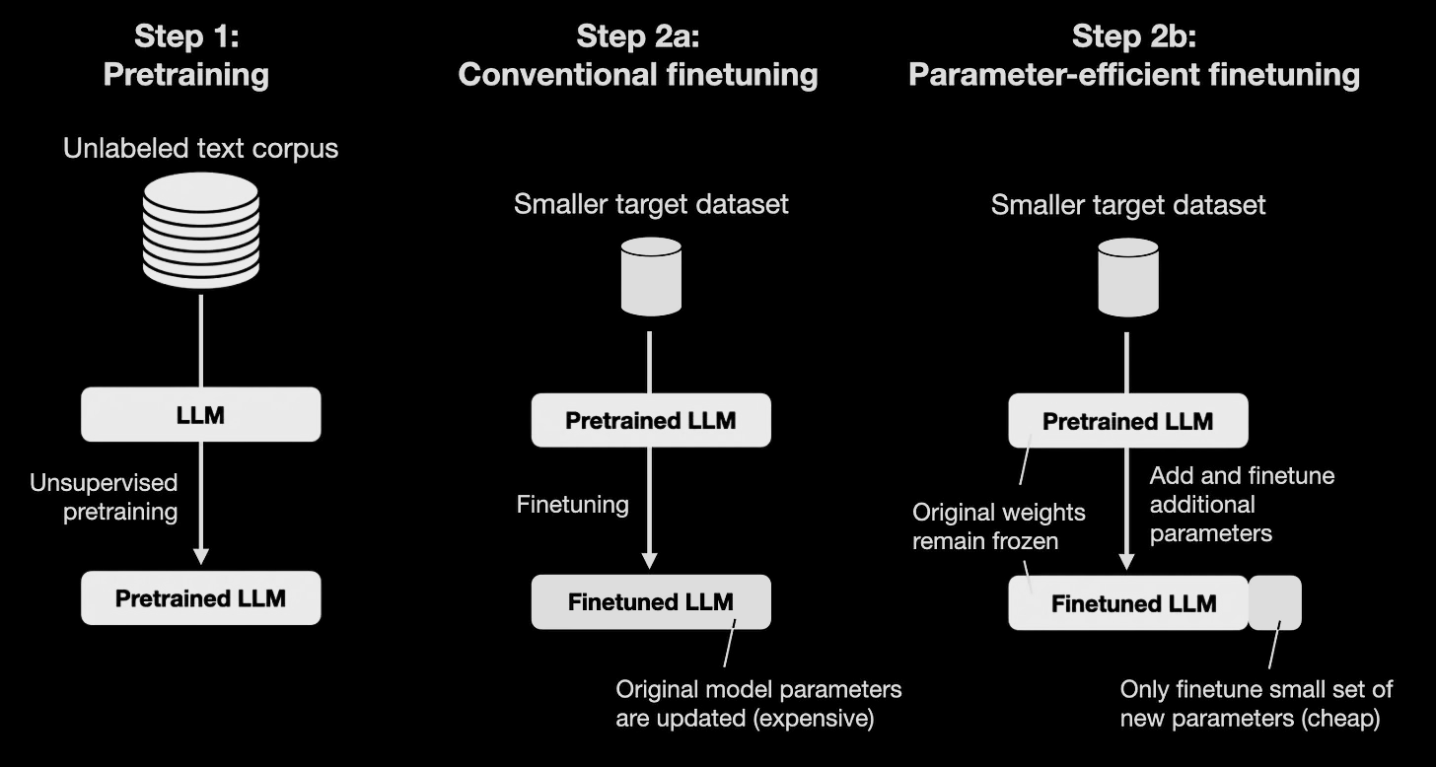
Decreasing costs with use of PEFT

Slide 14
Methodology
Data Engineering for Non-Technical Roles Assessment
And Fine tuning
Devops practices for Deployment
AI Proctoring
Mechanisms
Benchmarking
Open soucre LLMS
Website Development
Parameter-Efficient Fine-Tuning (PEFT)

Slide 15
Target LLMs
To evaluate and compare open-source LLMs, selecting the most optimal one for the development of COGNIASSESS.
LLMs under Consideration:
Llama 2
Claude 2
MPT-7B
Falcon LLM
Vicuna-13B
Key Performance Metrics:
Response Accuracy
Inference Speed
Scalability
Outcome :The selection of the most suitable LLM, enhancing the reliability and efficacy of COGNIASSES

Slide 16







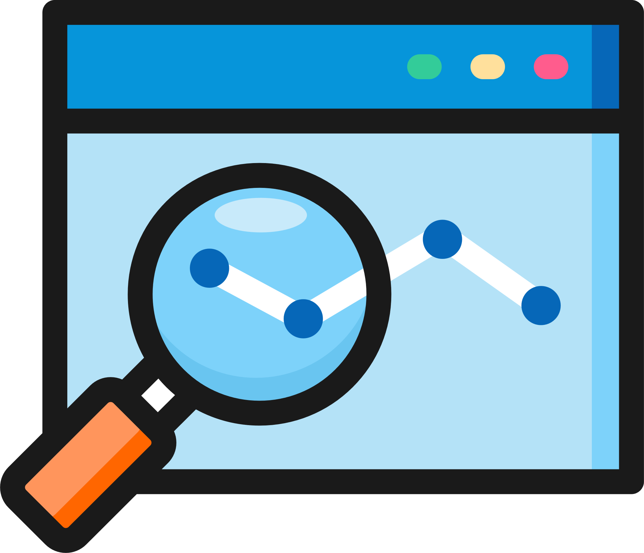



Example
Ali
Worked with Junoon band to optimize their Social media.
Uploads CV
CV analyzed
LLM generates personalized assessment
If Junoon had a bad concert, how would you post for it without hammering their repute?
Candidate Rankings
Ali
Recruiter
AI proctoring

Slide 17
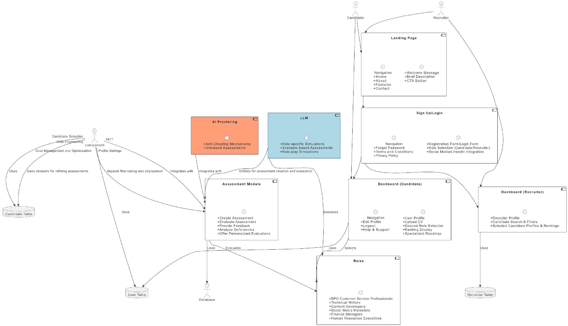
Architectural Diagram
Ali

Slide 18
Resource Requirments
Challenge: Fine-tuning large models require substantial GPU memory, leading to significant expenses.
Innovative Solutions: LoRa and QLoRa can mitigate costs and facilitate economical fine-tuning.
Economical Platforms: Google Colab Pro ($9.72/month) offers flexibility and is a cost-effective option for development needs.
Personal Computer Option: A PC with a graphics card of a minimum of 16 GB VRAM is another budget-conscious option, suitable for fine-tuning extensive language models.
Cost Effectiveness: Open-source models and efficient fine-tuning methods, like QLoRa, ensure considerable savings in cost, even during high traffic.
Example of Estimated Costs: Falcon 7B Model: $9.99 for development using Google Colab Pro and approximately $1.006/hour for deploying with a single GPU machine.

Slide 19
Expected outcomes
Advanced Personalization
Bias Minimization
Real-time Feedback
Anti-Cheating mechanism
Holistic Evaluations
Global Applicability
Recruiter Connection

Slide 20
Semester Plan
Data Engineering
Objective: Develop robust data models and streamline data processing.
Week 1-2:
Detailed Requirement Gathering
Initial Data Collection and Analysis
Week 3-4:
Data Model Development
Data Processing and Cleaning
Fine Tuning
Objective: Optimize LLMs and algorithms to align with diverse non-technical roles assessments.
Week 5-6:
LLM Fine-tuning
Preliminary Testing and Adjustment
Prototype
Objective: Achieve a 40% complete and functional prototype, ready for submission.
Week 7-8:
Finalizing Prototype
Preparing and Submitting Interim Report

Slide 21
Testing Results
Zephyr-7B underwent rigorous evaluation and validation for COGNIASSESS platform standards.
Dataset Partitioning: 90% of data used to fine-tune the model on the specific tasks, while 10% of data used to evaluate the model’s performance.
Performance Metrics: Computed accuracy, precision, recall, and F1-score to assess the model’s effectiveness..
Real-Time Monitoring with TensorBoard:
Real-time loss graphs for learning progress.
Visualized evaluation metrics for issue identification
Model Adjustments and Continuous Improvement: Based on evaluation results, continuous cycle of training, evaluation, and refinement. Iterative process ensured the model achieved the desired accuracy and performance levels.

Slide 22
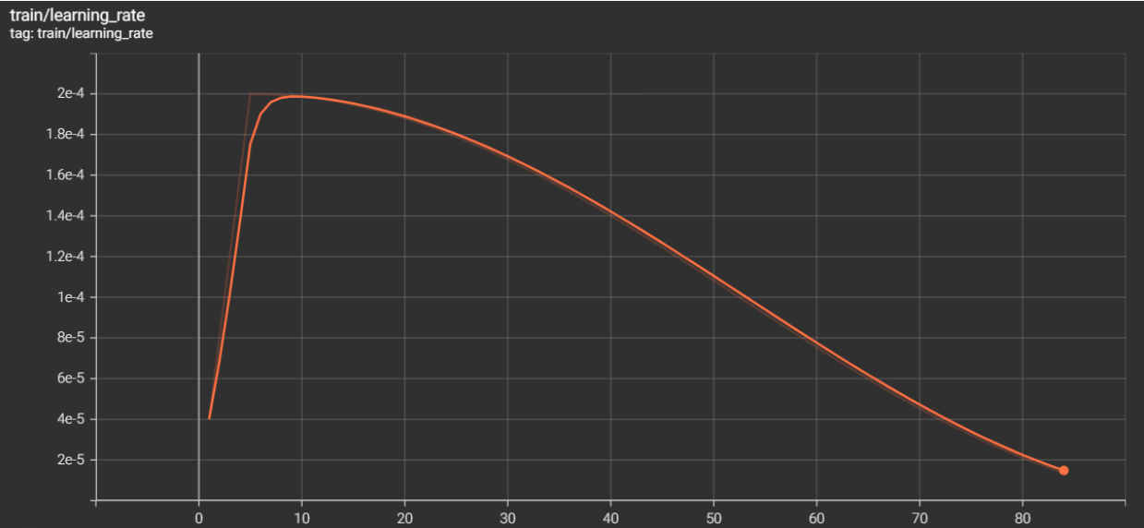
Learning Rate / Epoch

Slide 23
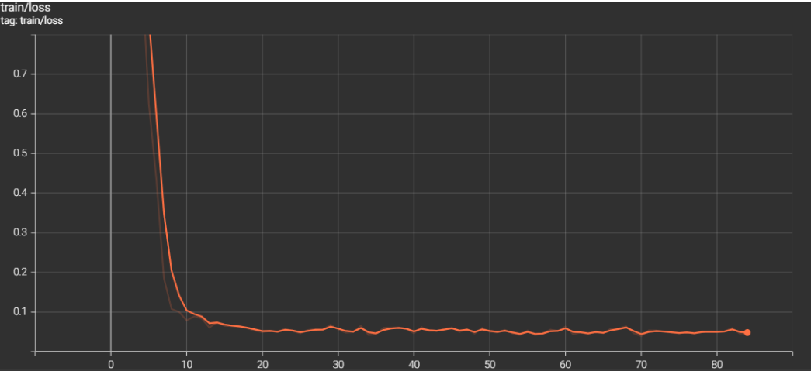
Training loss / Epoch
Notes:
Through this detailed evaluation and validation process, the Zephyr-7B model was thoroughly vetted and optimized for its deployment in the COGNIASSESS platform, ensuring its readiness for real-world application. We achieved the following loss graph

Slide 24
Frontend Design and Workflow
Developed the frontend design with Figma, emphasizing flexibility and collaboration. Translated the design into a functional website with a seamless user journey.
Registration Verification: Verifying the user’s registration status. Ensure access for registered users only.. Successful verification leads to the next stage.
Role Selection: Verified users select from five roles for self-assessment. Tailoring experience to align with professional interests.
Domain Selection: After role selection, choose relevant domains. Fine-tune assessments for alignment with chosen field.
CV Upload and Analysis: Users upload CV for system analysis. Extracting key details to personalize assessments.

Slide 25
Frontend Design and Workflow
Personality and Scenario-Based Assessments:
Progress to personality assessment phase.
LLM generates personality and job scenario questions.
Questions crafted for real-world challenges, ensuring relevance
Feedback and Ranking:
LLM evaluates user responses, generates personalized feedback.
Contributes to the user's overall platform ranking.
Critical for recruiters, provides a reliable metric to connect with candidates.

Slide 26
Frontend Design and Workflow
Developed the frontend design with Figma, emphasizing flexibility and collaboration. Translated the design into a functional website with a seamless user journey.
Registration Verification: Verifying the user’s registration status. Ensure access for registered users only.. Successful verification leads to the next stage.
Role Selection: Verified users select from five roles for self-assessment. Tailoring experience to align with professional interests.
Domain Selection: After role selection, choose relevant domains. Fine-tune assessments for alignment with chosen field.
CV Upload and Analysis: Users upload CV for system analysis. Extracting key details to personalize assessments.

Slide 27
THANK YOU

